Slide 1
Training Models

Slide 2
Classification
01
02
03
05
06
04
Linear Regression
Gradient Descent
Polynomial Regression
Learning Curve
Regularized Linear Models
Logistic Regression

Slide 3
01
Linear Regression

Slide 4



Linear Regression
A linear model makes a prediction by simply computing a weighted sum of the input features, plus a constant called the bias term
Linear Regression model prediction:
ŷ is the predicted value.
n is the number of features.
xi is the i th feature value.
θj is the j th model parameter.
Linear Regression model prediction (vectorized form):
θ: the model’ s parameter vector.
x: the instance’s vector
MSE cost function for a Linear Regression mode

Slide 5



The normal Equation
To train Linear Regression model, we need to find the value of that minimize the cost function (RMSE)
The normal equation:
θ is the value of θ that minimizes the cost function.
y is the vector of target value
X+ is the pseudoinverse of X (SVD)

Slide 6
Computational Complexity
Normal Equation: O(n^(2,4)) to O(n^3)
Normal Equation use SVD : O(n^2)
=> Very slow when the number of feature grow large

Slide 7
02
Gradient Descent

Slide 8
Gradient Descent
A generic optimization algorithm capable of finding optimal solutions to a wide range of problems.
General idea: tweak parameters iteratively in order to minimize a cost function.
It measures the local gradient of the error function with regard to the parameter vector θ, and it goes in the direction of descending gradient. Once the gradient is zero, you have reached a minimum.
An important parameter in Gradient Descent is the size of the steps(the learning rate hyperparameter ).
Small -> take a long time
High -> jump across the valley and end up on the other side.

Slide 9

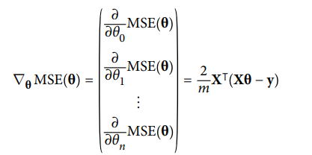

Batch Gradient Descent
To implement Gradient Descent, you need to compute ther gradient of the cost function with regard to each parameter θj.
Partial derivatives of the cost function:
Instead of computing these partial derivatives individually, we use the gradient vector:
Having the gradient vector, which point uphill, just go in the opposite direction to go downhill.
Gradient Descent step:

Slide 10
Stochastic Gradient Descent
Batch Gradient Descent use whole training set to compute the gradients at every step -> slow when training set is large.
On the other hand, Stochastic Gradient Descent pick a random instance in the training set at every step and compute the gradients base on a single instance.
Advantage: make algorithm much faster

Slide 11
Stochastic Gradient Descent
Disadvantage: due to its stochastic nature the cost function will bounce up and down. Over time it will end up close to minimum but once it gets there, it still bounce up and down
-> the final parameter values are good, but not optimal
Solve problem: gradually reducing the learning rate (The function that determine the learning rate at each iteration is the learning schedule)
Because instances are picked randomly , some instance may not be picked at all. If we want to algorithm goes through every instance, another approach is to shuffle the training set.

Slide 12
Mini-Batch Gradient Descent
Compute the gradient on small random sets of instance (Mini-Batch)

Slide 13
03
Polynomial Regression

Slide 14
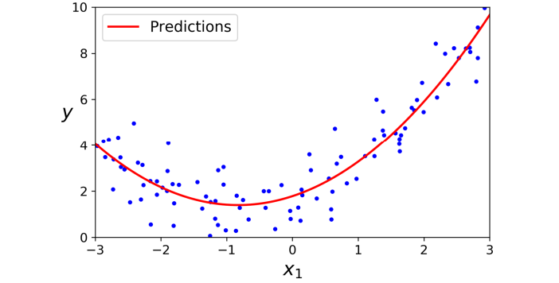
Polynomial Regression
If our data is more complex than a straight line, add power of each feature as new feature, then training a linear model on this extended set

Slide 15
04
Learning Curve

Slide 16
Learning Curve
To get estimate of a model’s generalization performance
(Polynomial Regression)
Using the cross-validation:
- Good at training data, poor in the cross validation => overfitting.
- Poor at training data, poor in the cross validation => underfitting.
Looking at Learning Curve: plot of model performance on the training set and the validation set.

Slide 17
The Bias and Variance Trade-Of
Bias: due to wrong assumption. A high bias model is most likely underfitting of training data.
Variance: due to the model’s excessive sensitivity to small variations in the training data. A model with many degrees of freedom is likely to have high variance and this overfitting training data.
Irreducible error due to the noise of the data. To solve this clean up the data.

Slide 18
05
Regularized Linear Models

Slide 19

Regularized Linear Model
A simple way to regularize a polynomial model is to reduce the number of polynomial degrees.
For a linear model, regularization is typically achieved by constraining the weights of the model

Slide 20


Ridge Regression
Ridge Regression (Tikhonov regularization) is a regularized version of Linear Regression.
Ridge Regression forces the learning algorithm to not only fit the data but also keep the model weights as small as possible.
Ridge Regression cost function:
The hyperparameter α controls how much you want to regularize the model.
Small: Ridge Regression is just Linear Regression
Large: all weights -> 0 and the result is a flat line.
Ridge Regression closed-form Solution

Slide 21

Lasso Regression
Least Absolute Shrinkage and Selection Operator Regression (usually simply called Lasso Regression) is another regularized version of Linear Regression.
It is similar to Ridge Regression.
Lasso Regression cost function:
An importance characteristic of Lasso Regression ( Ridge Regression do not have): it tend to eliminate the weight of least importance feature.

Slide 22

Elastic Net
The middle ground between Ridge Regression and Lasso Regression.
Elastic Net cost function
Note:
Ridge Regression is good defaut.
If we suspect that only a few features are useful, we should prefer Lasso Regression and Elastic Net. ( Elastic Net is preferred)

Slide 23
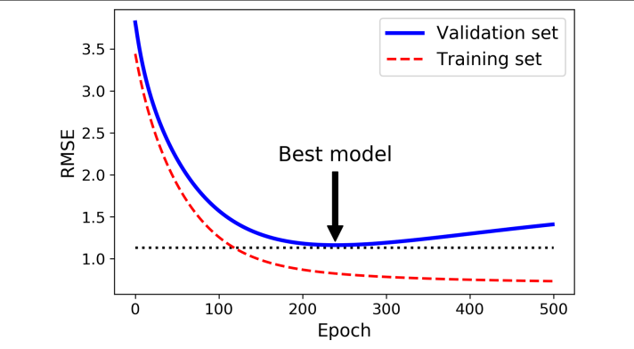
Early Stopping
A very different way to regularize iterative learning algorithms such as Gradient Descent is to stop training as soon as the validation error reaches a minimum

Slide 24
06
Logistic Regression

Slide 25

Logistic Regression
Some regression algorithm can be used for classification (and vice versa). Logistic Regression is commonly used to estimate the probability that an instance belongs to a particular class.

Slide 26



Estimating Probability
Like a Linear Regression model, a Logistic Regression computes a weighted sum of input feature, but instead of outputting the result directly like the Linear Regression model does, it outputs the logistic of this result
Logistic Regression model estimated probability (vectorized form):
Logistic function:
Logistic Regression model prediction:

Slide 27



Training And Cost Function
The objective of training is to set the parameter vector θ so that the model estimate high probabilities for positive instance and low probabilities for negative instance.
This idea is capture by the cost function for single instance.x:
The cost function over the whole training set is the average cost over all training instances. It can be written in a single expression called the log loss:
The good news is that this cost function is convex, so Gradient Descent is guaranteed to find the global minimum .
Logistic cost function partial derivatives:

Slide 28
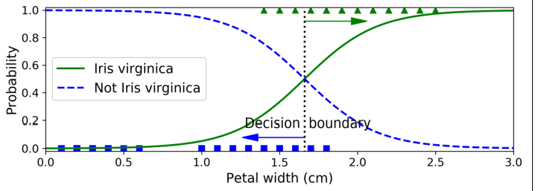
Decision Boundaries
A decision boundary is the region of a problem space in which the output label of a classifier is ambiguous.
Example:

Slide 29




Softmax Regression
The Logistic Regression model can be generalized to support multiple classes directly, without having to train and combine multiple binary classifiers.
The idea : when given an instance x -> computes a score Sk (x) for each class k
-> estimates the probability of each class by applying the softmax function ( normalized exponential) to the scores -> predict the class with the highest estimated probability.
Softmax score for class k:
Softmax function:
Cross entropy cost function:
Use Gradient Descent (or any other optimization algorithm) to find the parameter matrix Θ that minimizes the cost function.

Slide 30
Thanks for Watching

